Slide 1
Final Presentation
BY
CHANDANA GANASALA-301382394
SREEHASA KOTTE-301078558
Latex Link: https://www.overleaf.com/read/rrnxdvhqcbjk#94eb2c

Slide 2
CONTENTS:
Abstract
Introduction
Literature review
Proposed Solution
Preliminary results
Conclusion

Slide 3
ABSTARCT:
Recommender Systems' role in personalized recommendations for user satisfaction.
Specific attention to Streaming Systems in live content streaming industries.
Challenges in Streaming Systems: Real time data handling & accuracy in dynamic scenarios
Novel Solution - Matrix Factorization with Lovian Algorithm
Proposed solution - Addressing data scarcity to enhance recommendation accuracy in live content streaming.

Slide 4
INTRODUCTION:
Introduction to Recommender Systems (RS):
  Acknowledges the enduring interest in Recommender Systems over the past two decades with diverse applications.
Focus on Streaming Systems:
  Highlights the specific focus on Streaming Systems, a subset of RS widely used in various industries.
  Points out the time-sensitive nature of streaming systems, especially in live content streaming, where recommendations adapt rapidly to live events.

Slide 5
3. Role of Cloud-Based Stream Processing Technologies:
  Discusses the significance of cloud-based stream processing technologies in managing real-time data streams for live streaming platforms.
  Emphasizes the importance of these technologies in maintaining responsiveness and agility for real-time suggestions during live streaming.
4. Challenges in Live Streaming:
  Identifies challenges in live streaming, including handling enormous real-time data streams, retaining recommendation accuracy in rapidly changing scenarios, and addressing inadequacies of traditional algorithms in dynamic situations.

Slide 6
5. Proposal of Community-Based Matrix Factorization:
Introduces a novel approach, matrix factorization with lovian algorithm, as a solution to challenges in live content streaming.
Outlines the methodology's goal: overcoming data scarcity and improving recommendation accuracy in dynamic live streaming environments.
Our proposed algorithm will offer a promising solution to the identified issues in existing systems.

Slide 7
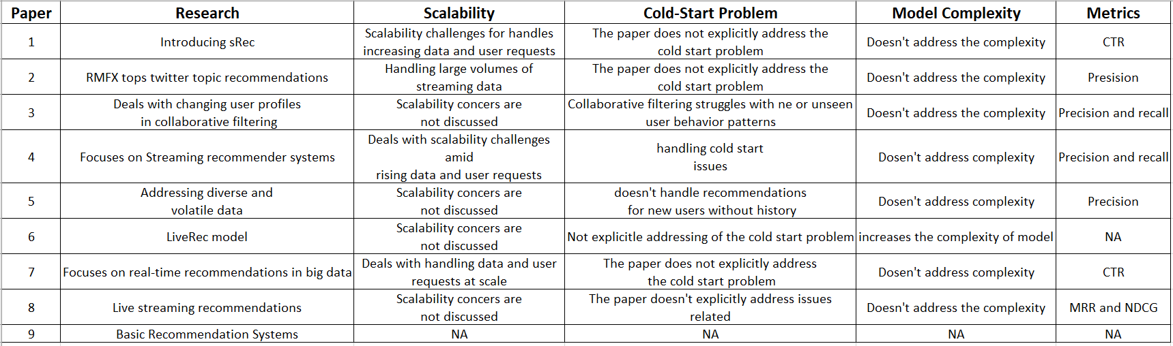
LITERATURE REVIEW

Slide 8
Common limitations identified in your literature review on "dynamic data streaming for recommendations":
1. Limited Evaluation Methodology
2. Increased Sparsity of Data
3. Scalability Issues

Slide 9
PROPOSED SOLUTION AND INTENDED CONTRIBUTIONS
Matrix Factorization with Louvian Algorithms

Slide 10
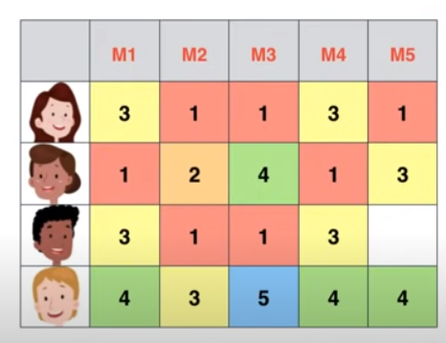

Slide 11
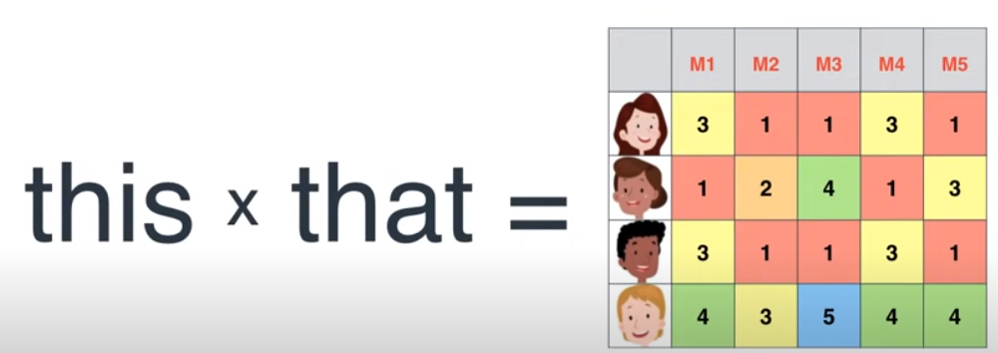
MATRIX FACTORIZATION
Factorization
6 X 4 = 24
Matrix Factorization

Slide 12
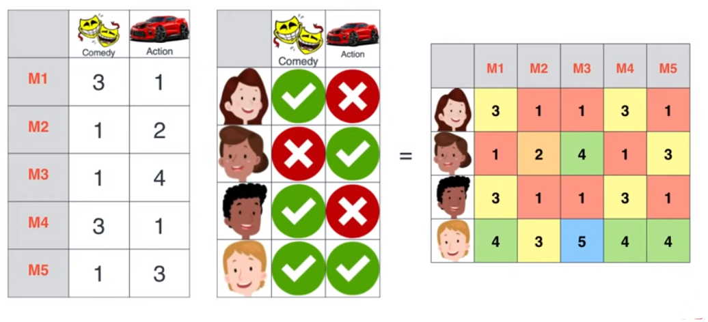

Slide 13
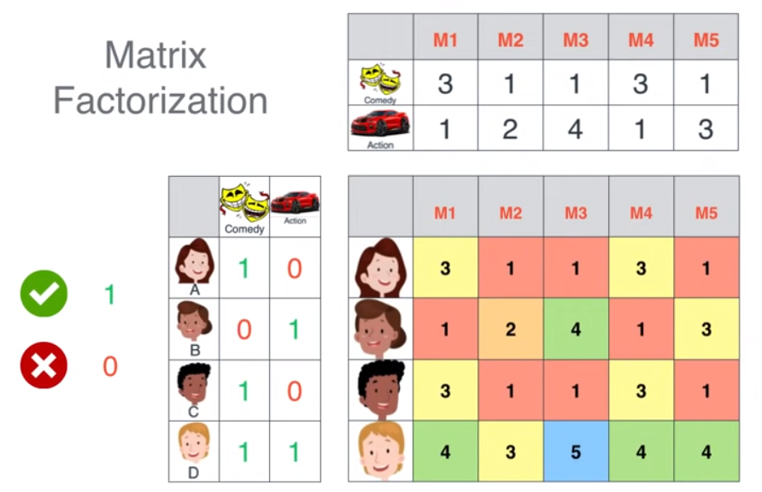

Slide 14
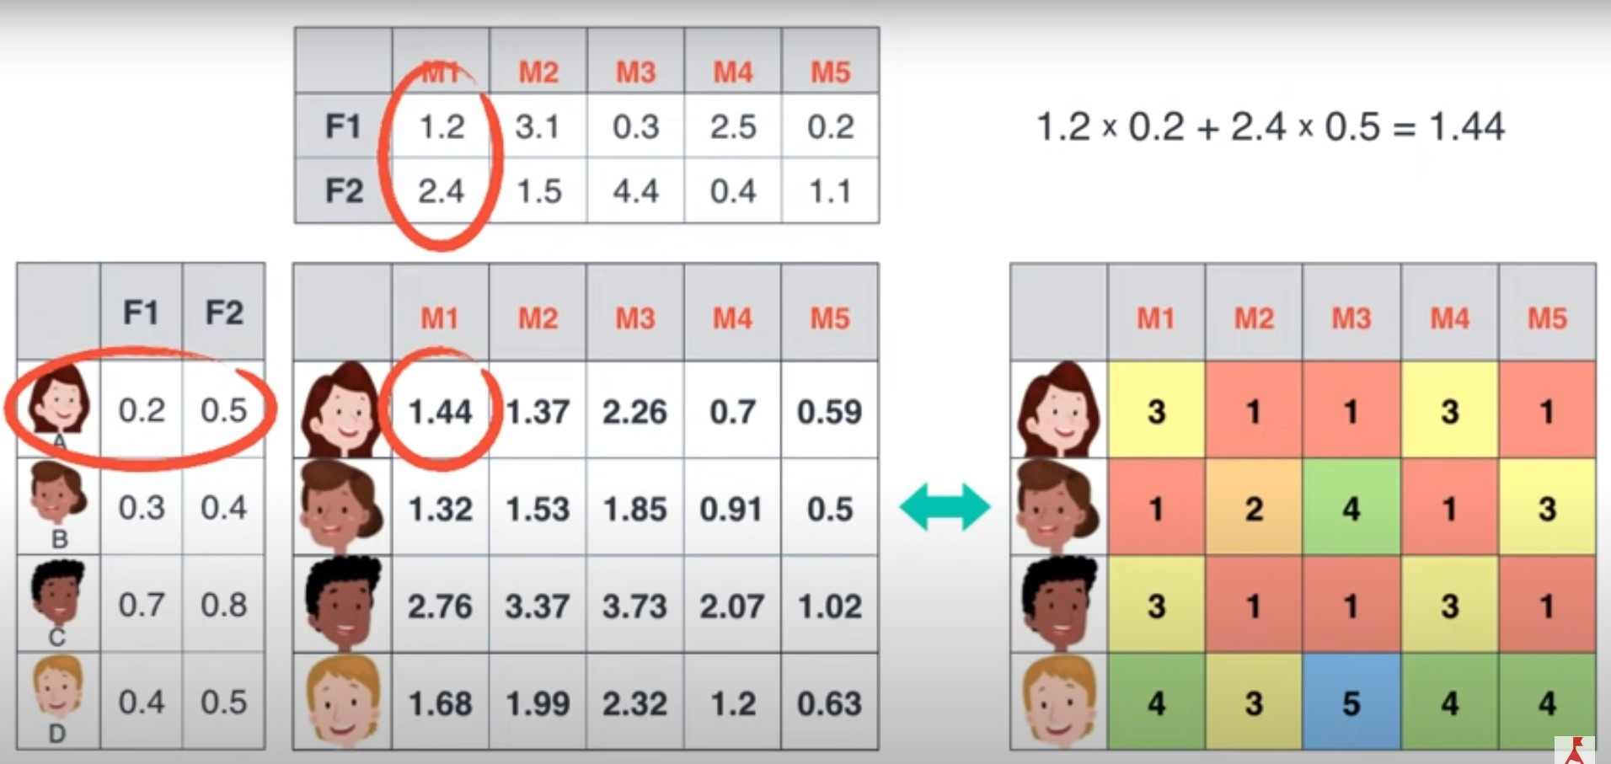

Slide 15
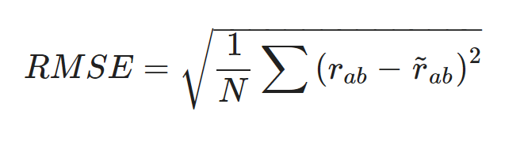
Error Function:

Slide 16
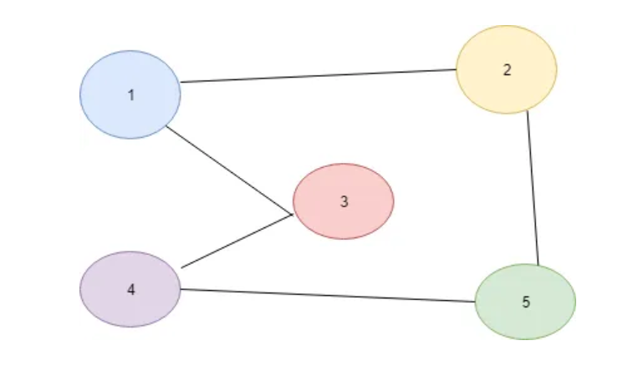
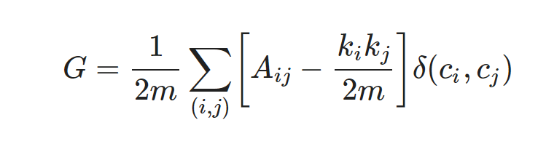
Community Detection - Louvain Algorithm
G = Modularity
m = Weights of all edges in the graph (if unweighted graph, the count of edges in the entire graph)
The summation has 3 terms
Aᵢⱼ = weight of the edge between node ‘i’ & node ‘j’ if weighted graph else 1 if edge between node i & j exists else 0 (in case of unweighted graph)
Kᵢ is the degree (total connections) of some node i.
δ(cᵢ, cⱼ) = 1 if both node i & node j are in same community else 0

Slide 17
Modularity =
1/2m x [(A₁₁ — k₁k₁/2m) x δ(c₁,c₁)+(A₁₂ — k₁k₂/2m) x δ(c₁,c₂) + (A₁₃ — k₁k₃/2m) x δ(c₁,c₃) + (A₁₄ — k₁k₄/2m) x δ(c₁,c₄) + (A₁₅ — k₁k₅/2m) x δ(c₁,c₅) +
(A₂₁ — k₂k₁/2m) x δ(c₂,c₁) + (A₂₂ — k₂k₂/2m) x δ(c₂,c₂)+ ……
(A₅₄ — k₅k₄/2m) x δ(c₅,c₄)+ (A₅₅ — k₅k₅/2m) x δ(c₅,c₅) ]
Putting values in it
= 1/2*5 x [ (0–2*2/2*5) x 1 + (1–2*2/2*5)x 0 + (1–2*2/2*5)x0 + (0–2*2/2*5) x 0 + (0–2*2/2*5) x 0+
((1–2*2/2*5)x 0) + (0–2*2/2*5) x 1 ……((1–2*2/2*5)x 0) + (0–2*2/2*5) x 1]

Slide 18
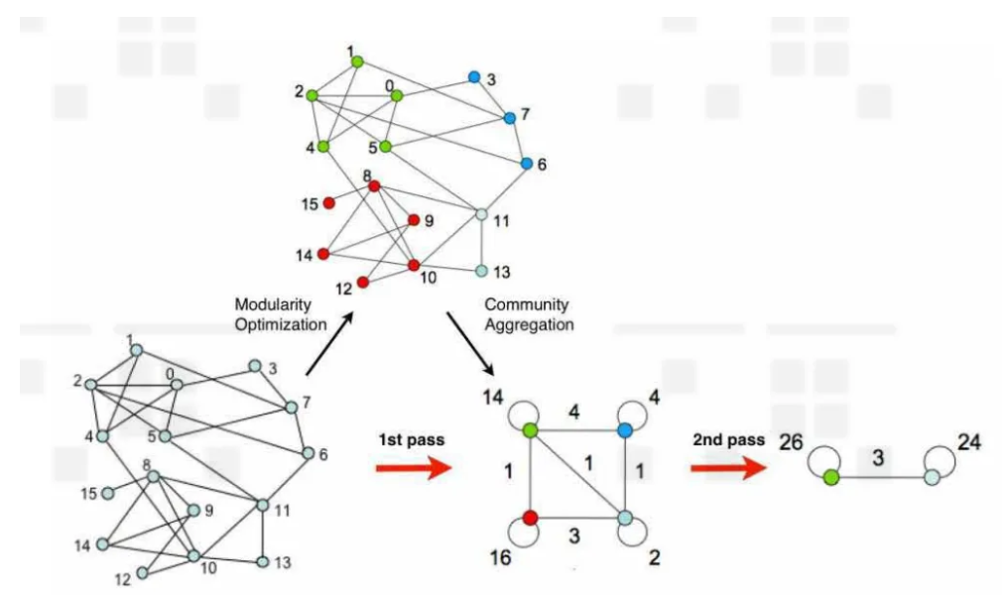

Slide 19
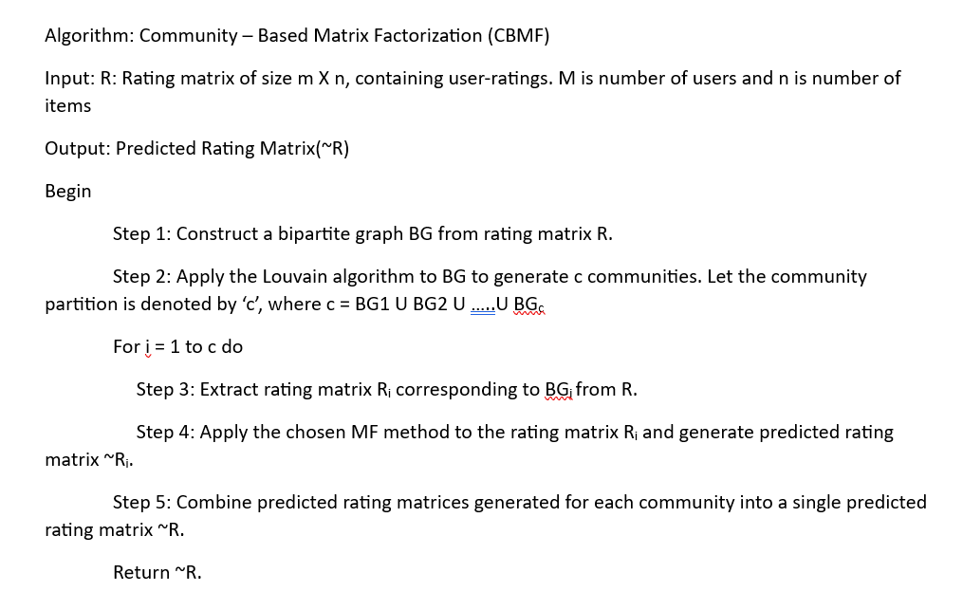
Algorithm:

Slide 20
Steps:
Our proposed approach has the following steps:
(1) Model the rating network as a complex bipartite network.
(2) Divide the network into communities.
(3) Extract the rating matrices pertaining only to those communities and apply MF on these matrices in parallel.
(4) Merge the predicted rating matrices belonging to communities and evaluate the root mean square error (RMSE).

Slide 21
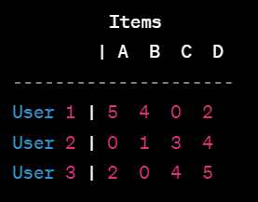
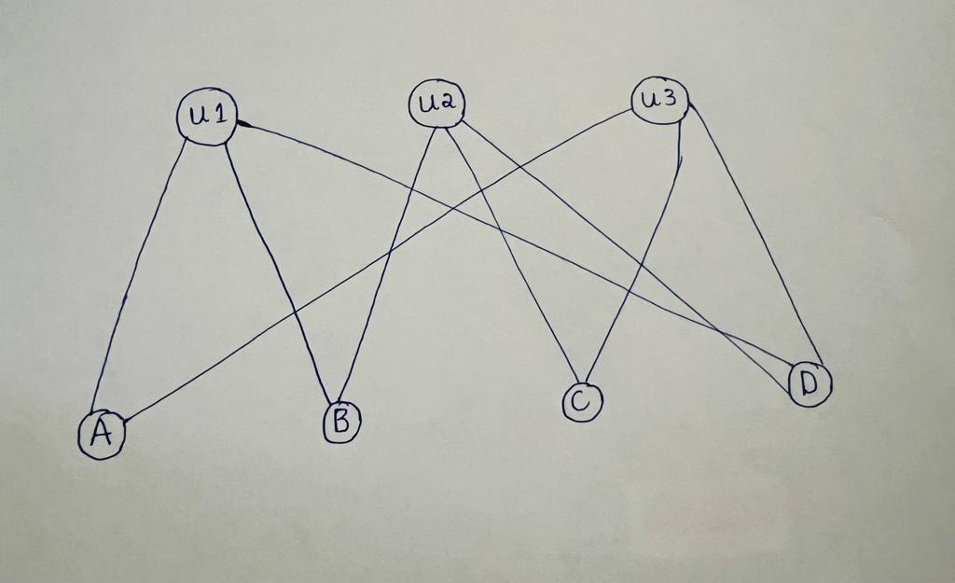
Example:
Step 1: The bipartite user-item graph is constructed.

Slide 22

Step 2: Apply Community Detection Algorithm:
Apply a community detection algorithm like the Louvain algorithm. Let's say the algorithm identifies two communities:

Slide 23
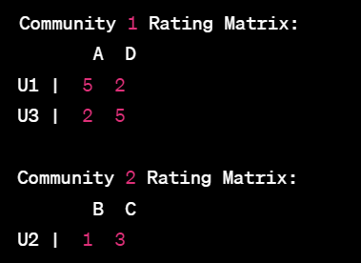
Step 3: Generate Community-Specific Rating Matrices:
Create smaller rating matrices for each community based on the identified nodes

Slide 24
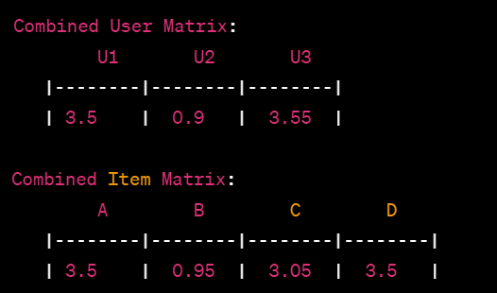
Step 4: Apply Matrix Factorization to Community Rating Matrices:
Apply matrix factorization independently to each community-specific rating matrix.

Slide 25
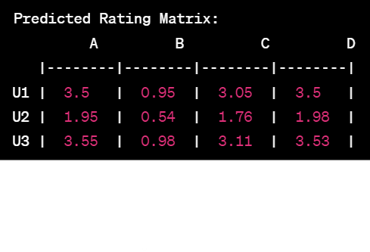
Step 5: Compute Predictions:
Multiply the combined user and item matrices to obtain predicted ratings for all user-item pairs:
This matrix represents the predicted ratings for each user-item pair in the original user-item interaction

Slide 26
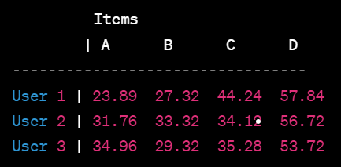
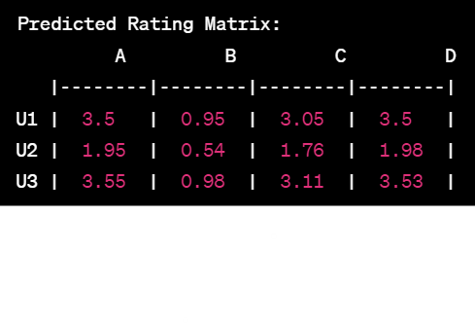
Basic Matrix Factorization: Matrix Factorization with Louvian:

Slide 27
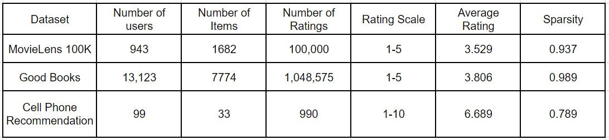
Preliminary results:
Data set:

Slide 28
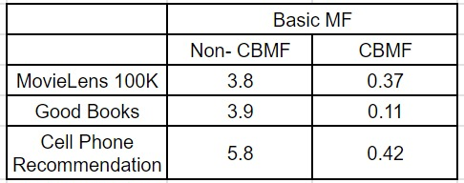
Expected Output:

Slide 29
Conclusion:
The paper initiates by exploring parallel computation as a focus of investigation.
Our approach is introduced as a novel approach that leverages community knowledge to parallelize matrix factorization.
The experimental results validate the effectiveness, demonstrating its scalability and speedup compared to sequential solutions.
Our approach is shown to outperform sequential solutions, providing solid evidence of its efficiency in dealing with scattered resources.

Slide 30


